Slide 1


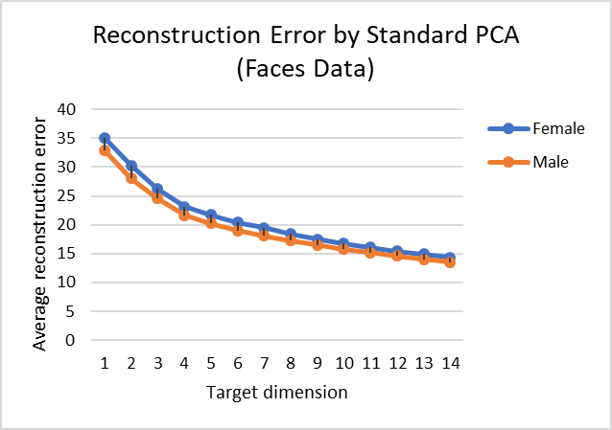
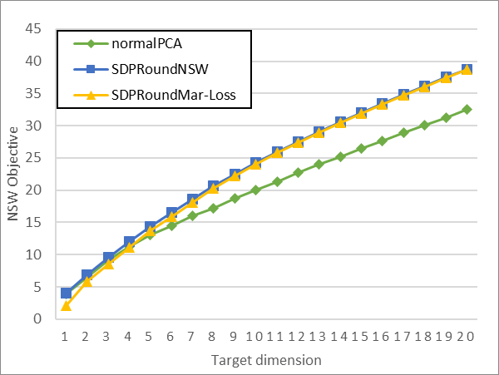
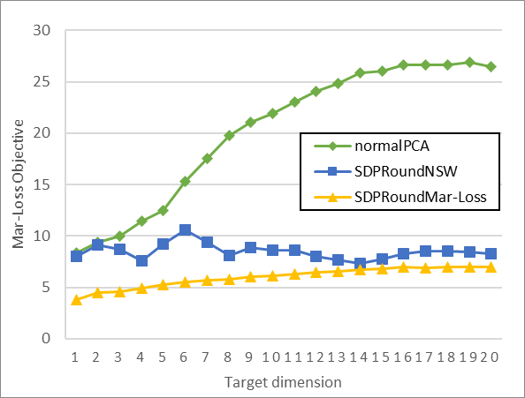
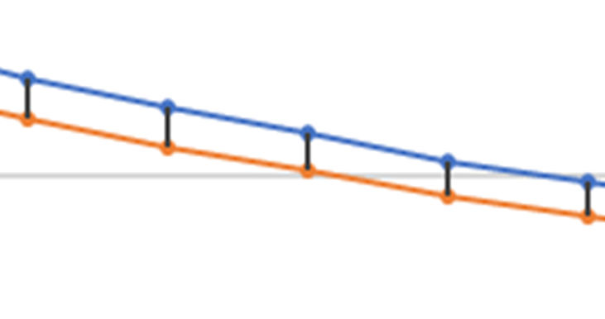
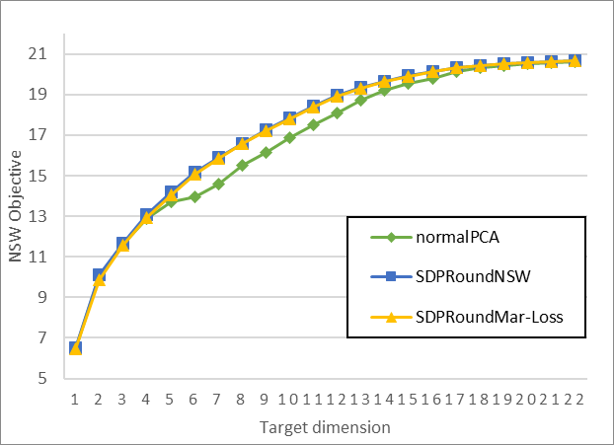
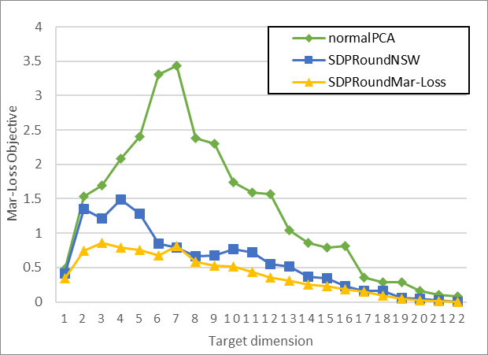
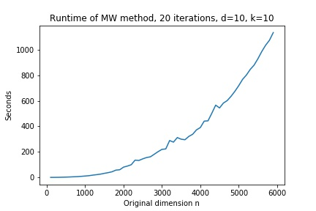







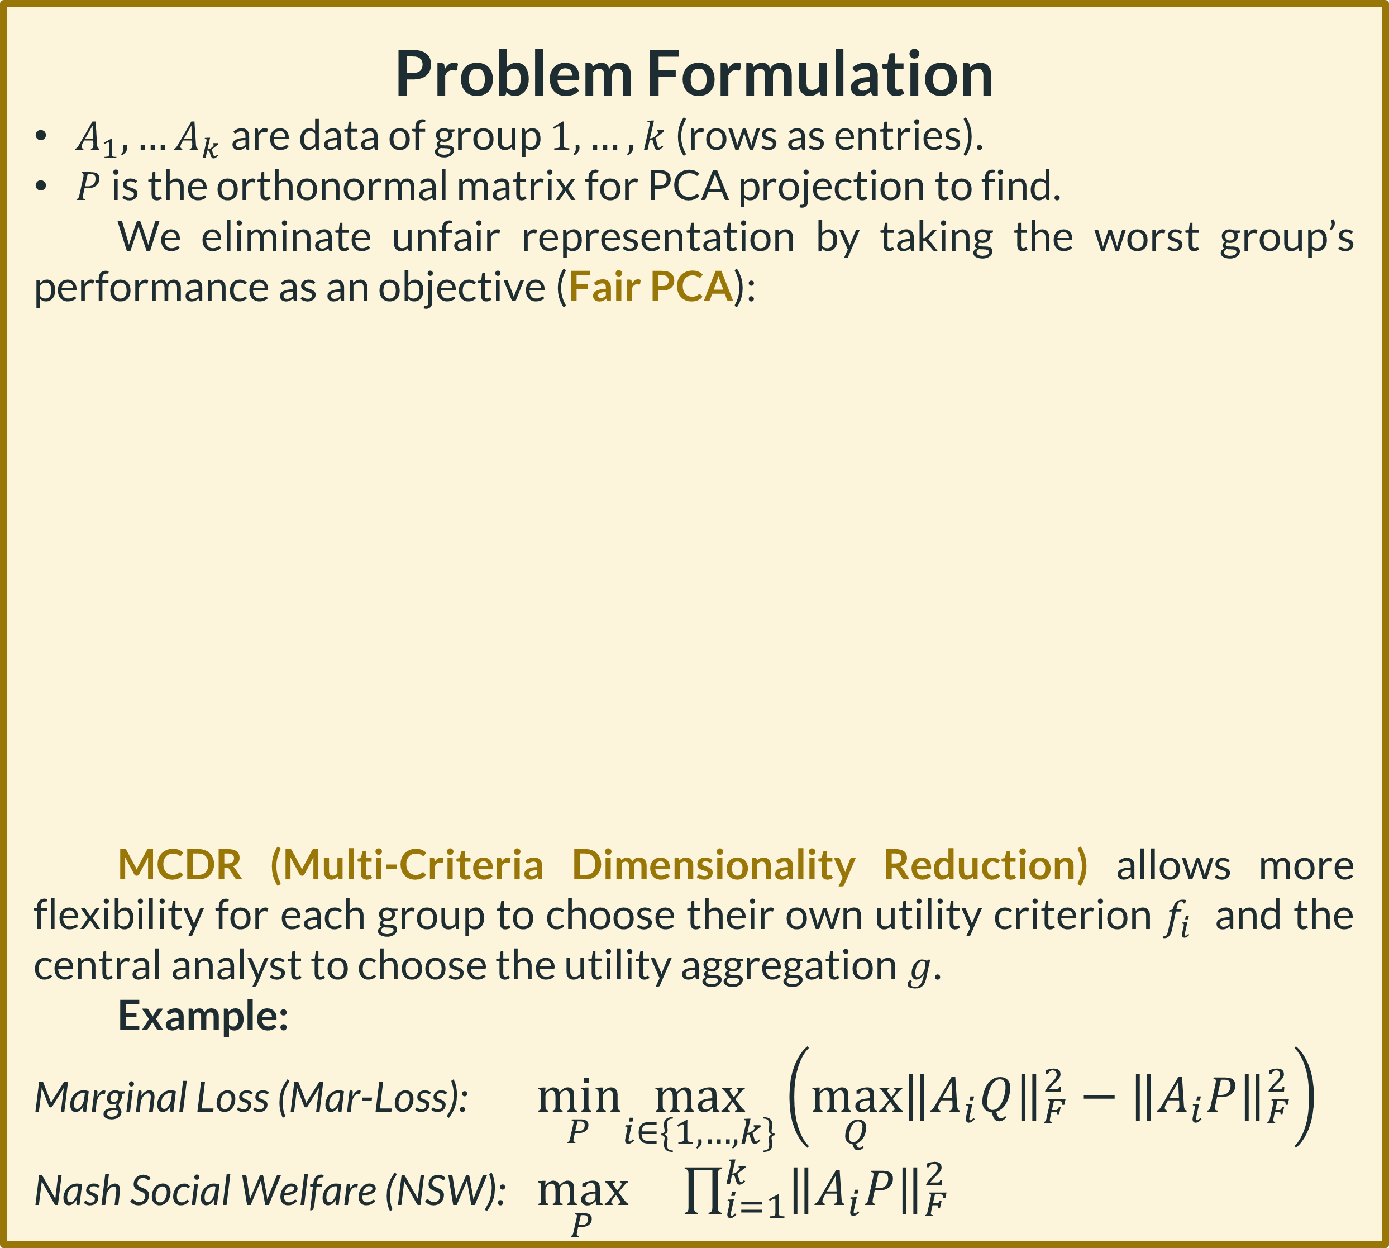
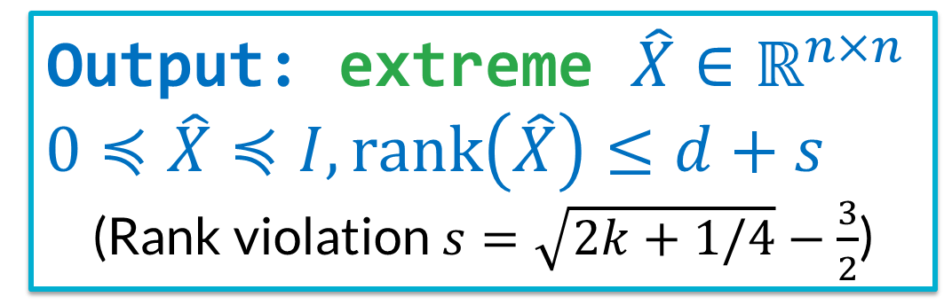


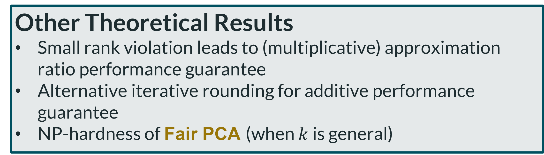
Multi-Criteria Dimensionality Reduction with Applications to Fairness Uthaipon (Tao) Tantipongpipat, Samira Samadi, Mohit Singh, Jamie Morgenstern, and Santosh Vempala
Georgia Institute of Technology
Motivation
Principle Component Analysis (PCA) is used in machine learning, natural sciences, and social sciences
But PCA can result in biased representation
More challenges:
Reweighting samples from each group to be equal does not fix the bias
Two PCAs for each group are not allowed for ethical and legal reasons
Algorithms
One can solve standard PCA by Singular Value Decomposition (SVD)
But SVD can’t solve Fair PCA or MCDR.
However, convex relaxation extends from standard PCA to Fair PCA and MCDR.
Experiments
We run our algorithm SDPRound specified two objectives Nash Social Welfare (NSW) and Marginal Loss (Mar-Loss) and compare with standard PCA on two metrics NSW and Mar-Loss. The rank violation in practice is much smaller than the guarantee and usually non-existent.
SDPRound performs better in both NSW and Mar-Loss objectives compared to standard PCA despite being optimized for only one objective.
Code: github.com/SDPforAll/multiCriteriaDimReduction
Web: sites.google.com/site/ssamadi/fair-pca-homepage
Convex Relaxation for Fair PCA
Input: data $A_{1},…,A_{k}$ in $n$ dimensions; target dimension $d≤n$
Output: projection matrix $X=PP^{T}$
Algorithm: solve semi-definite program (SDP)
$\max_{X∈ℝ^{n×n},z∈ℝ}{z}$ subject to
$z≤\left\langle A_{1}^{T}A_{1},X\right\rangle$
$⋮$
$z≤\left\langle A_{k}^{T}A_{k},X\right\rangle$
$Tr\left(X\right)≤d, 0≼X≼I$
Adult Income data; 5 groups based on race
32k datapoints, 59 dimensions
Efficiently solvable
Male is consistently
$≈$10% better than female
Output: $\hat{X}∈ℝ^{n×n}$
$$0≼\hat{X}≼I, tr\left(\hat{X}\right)≤d$$
Problem: $\hat{X}$has correct trace but higher rank than $d$
Default Credit data; 6 groups based on education and gender
30k datapoints, 21 dimensions
Problem Formulation
${A_{1},…A}_{k}$ are data of group $1,…,k$ (rows as entries).
$P$ is the orthonormal matrix for PCA projection to find.
We eliminate unfair representation by taking the worst group’s performance as an objective (Fair PCA):
MCDR (Multi-Criteria Dimensionality Reduction) allows more flexibility for each group to choose their own utility criterion $f_{i}$ and the central analyst to choose the utility aggregation $g$.
Example:
Marginal Loss (Mar-Loss): $\min_{P}\max_{i∈\{1,…,k\}}\left(\max_{Q}{{\left\|A_{i}Q\right\|}_{F}^{2}}−{\left\|A_{i}P\right\|}_{F}^{2}\right)$
Nash Social Welfare (NSW): $\max_{P} \prod_{i=1}^{k}{{\left\|A_{i}P\right\|}_{F}^{2}}$
Output: extreme $\hat{X}∈ℝ^{n×n}$
$$0≼\hat{X}≼I, rank\left(\hat{X}\right)≤d+s$$
(Rank violation $s=\sqrt{2k+1/4}−\frac{3}{2}$)
Solution: solve SDP to an extreme point
Main Theoretical and Algorithmic Contributions
Proof that any SDP extreme solution has low rank
Algorithm to move to extreme point solutions
Apply the result to Fair PCA and generalize to MCDR.
Our results apply to $f_{i}$’s linear in $PP^{T}$ and concave $g$, which cover well-studied welfare objectives including Mar-Loss and NSW.
Existence of low-rank property of SDP extreme point is known in optimization community (Barvinok’95, Pataki’98). We connect the result to ML application by generalizing the result to $X≼I$ constraint and developing the algorithms.
Standard PCA: $\max_{P} \sum_{i=1}^{k}{{\left\|A_{i}P\right\|}_{F}^{2}}$
Fair PCA: $\max_{P} \min_{i∈\{1,…,k\}}{\left\|A_{i}P\right\|}_{F}^{2}$
Scalability
SDP solvers run in <1 minutes on data with original dimension $n≈50−70$. For big data and large $n$, we use multiplicative weight update (MW) for certain objectives of MCDR. In practice, MW runs on $n≈$1000 dimensions in <20 minutes.
MCDR: $\max_{P} g(f_{1}\left(P\right),…,f_{k}\left(P\right))$
Other Theoretical Results
Small rank violation leads to (multiplicative) approximation ratio performance guarantee
Alternative iterative rounding for additive performance guarantee
NP-hardness of Fair PCA (when $k$ is general)
Notes:
Future direction
//pic of new data in small boxes, at some point changing its color
//detecting when entropy is increasing in a meaningful way

